Slide 1

22년 삼성 AI 전문가과정
6월 9일 목요일 6교시
장병탁
인공지능
21차시 : Human-Level AI
서울대학교 컴퓨터공학부
담당 교수: 장병탁
Seoul National University
Byoung-Tak Zhang

Slide 2
Lecture Overview
인공지능
21차시 : Human-Level AI
서울대학교 컴퓨터공학부
담당 교수: 장병탁
Seoul National University
Byoung-Tak Zhang

Slide 3
Introduction: Human-Level AI
Where are we headed?
What is the limit of AI?
Can machines really think?
The ethics of AI
What remains to be done?
Agent designs
Agent components
What’s missing?

Slide 4
Philosophy, Ethics, and Safety of AI
The Limits of AI
The argument from disability
The mathematical objection
The argument from informality
Can Machines Really Think?
The mind-body problem
The Chinese room
Consciousness and qualia
The Ethics of AI
What if the effects of AI are more negative than positive?
How to design a friendly AI?

Slide 5
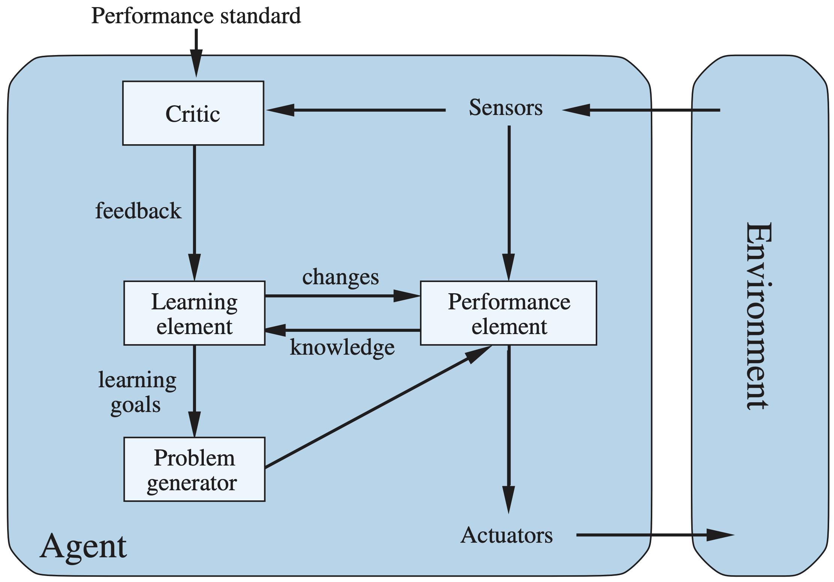
The Present of AI: What’s Known
In this course, we viewed AI as the task of designing rational agents. The progress we have made so far includes:
Agent designs
Reflex, goal-based, model-based, utility-based agents
Knowledge-based agent, decision-theoretic agent
Reinforcement learning agent (POMDP agents)
Component technologies
Reasoning: Logical, probabilistic, neural reasoning
Representation: Atomic, factored, structured representations
Learning: Various algorithms learning from various data
Sensors and actuators: Fully-observable, partially-observable, deterministic, stochastic

Slide 6
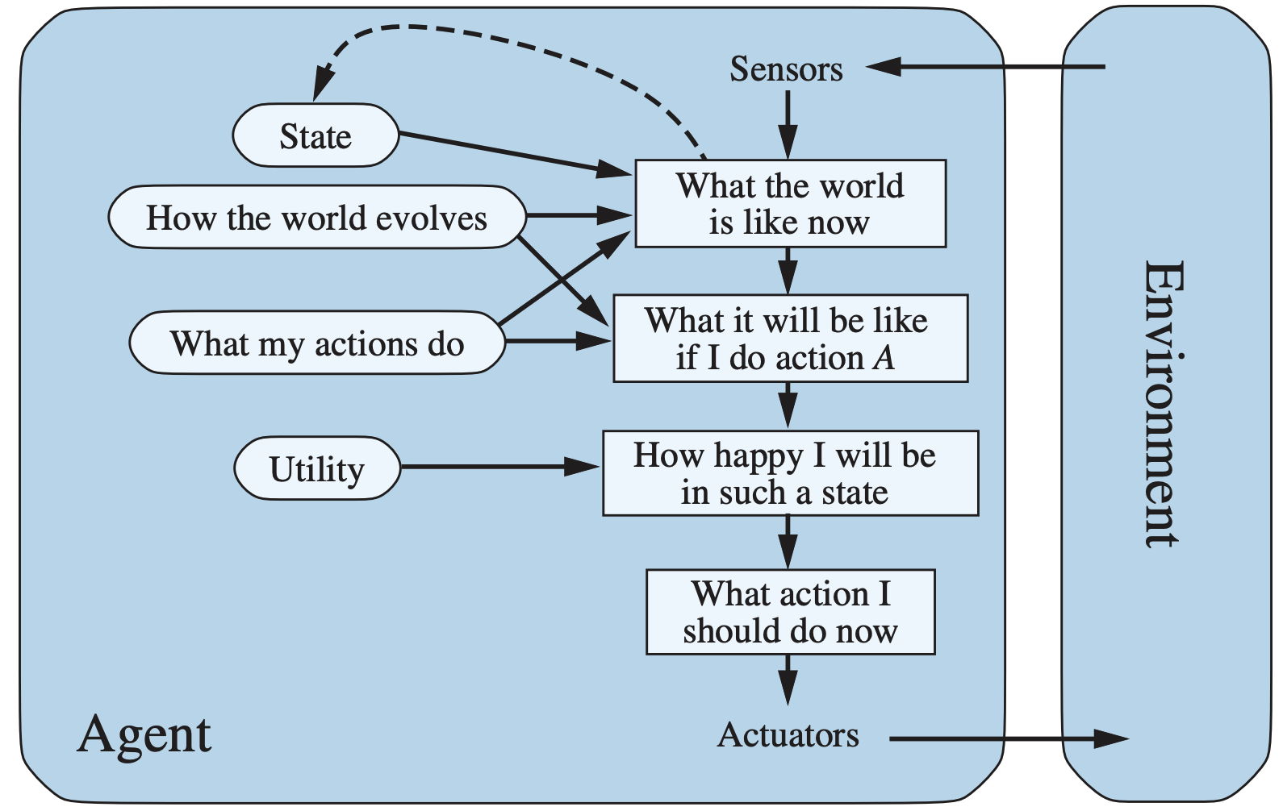
The Future of AI: What’s Missing
To achieve a human-level general-purpose intelligent agent that can perform well in a wide variety of environments, what’s missing in components and overall architecture of an intelligent agent?
Agent components
1) Interaction with the environment through sensors and actuators
2) Keeping track of the state of the world over time
3) Projecting, evaluating, and selecting future courses of action
4) Utility as an expression of preferences
5) Learning new abstract representations gradually
Agent architecture
Hybrid architecture: Reflex response as well as knowledge-based deliberation
Anytime algorithm: An algorithm whose output quality improves gradually over time
Meta-reasoning: Decision-theoretic evaluation of value as well as cost, reflective agent

Slide 7
Outline (Lecture 21)
21.1 The Limits of AI ………………………….
21.2 Can Machines Really Think? …………….
21.3 The Ethics of AI ……………….................
21.4 AI Components …………………………..
21.5 AI Architectures ………………………….
Summary .……………………………………....
7
14
22
26
30
36

Slide 8
21.1 The Limits of AI

Slide 9
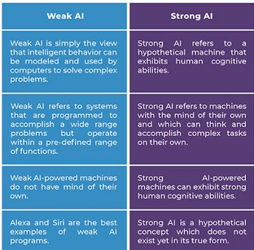
21.1 The Limits of AI (1/5)
1) Weak AI
Weak AI hypothesis: Machines could act as if they were intelligent
Strong AI hypothesis: Machines that do so are actually thinking (not just simulating thinking)
Weak AI is possible: “Every aspect of learning or any other feature of intelligence can be so precisely described that a machine can be made to simulate it.” (McCarthy et al., 1955)

Slide 10
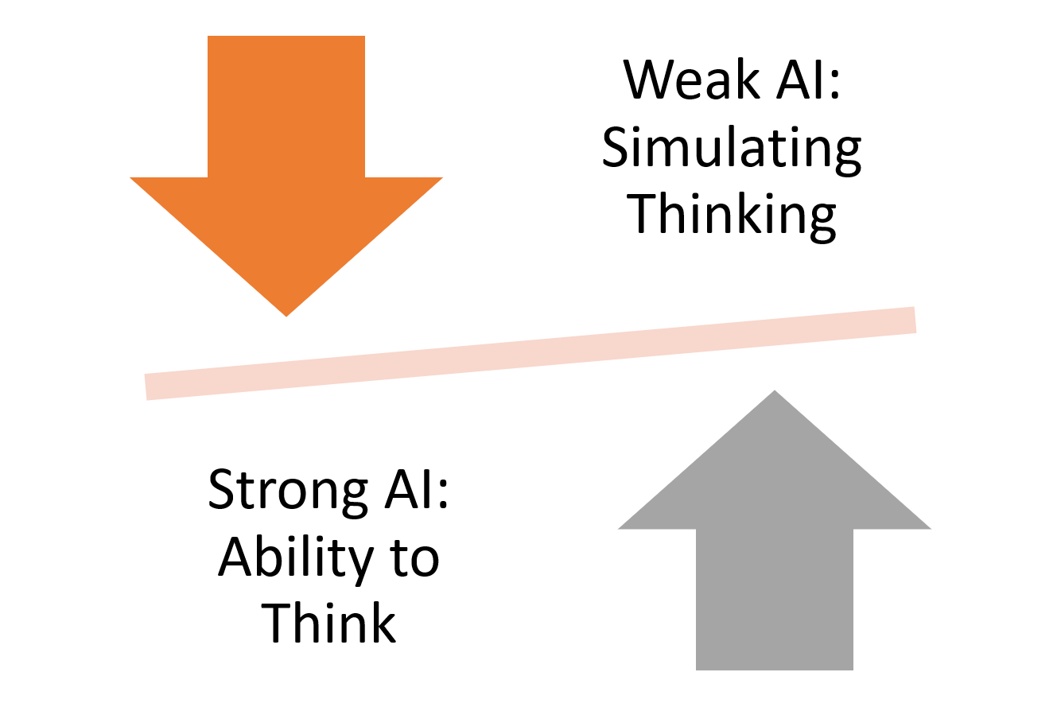
21.1 The Limits of AI (2/5)
1) Weak AI
“Can machines think?”: “The question of whether Machines Can Think . . . is about as relevant as the question of whether Submarines Can Swim.” (Dijkstra, 1984)
Turing Test (Alan Turing, 1950): Instead of asking whether machines can think, we should ask whether machines can pass a behavioral intelligence test, which has come to be called the Turing Test.
https://jrodthoughts.medium.com/g%C3%B6del-consciousness-and-the-weak-vs-strong-ai-debate-31afea7e0a36

Slide 11
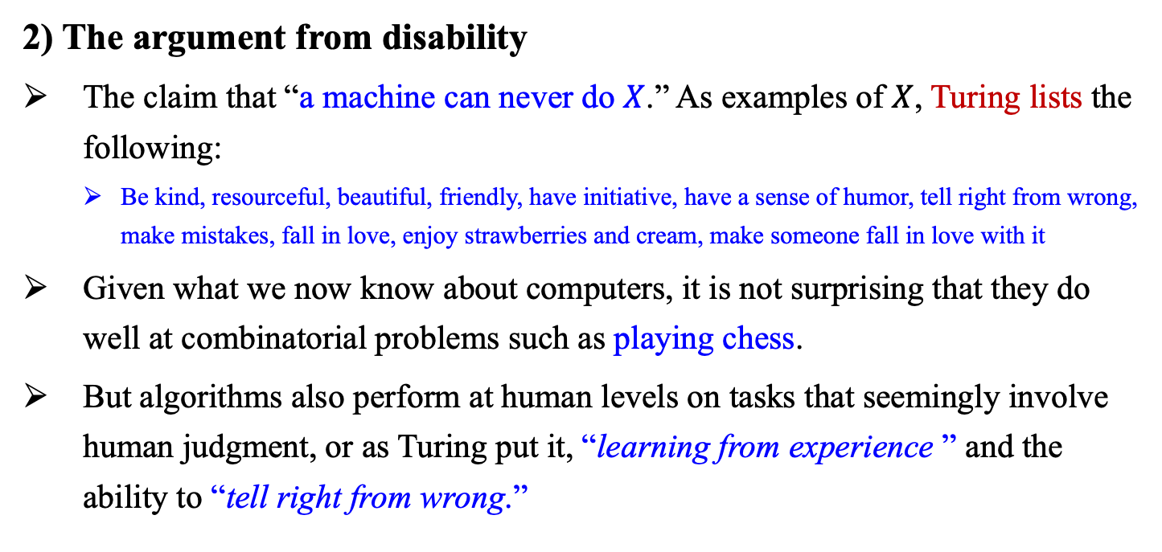
21.1 The Limits of AI (3/5)
2) The argument from disability
The claim that “a machine can never do $X$.” As examples of $X$, Turing lists the following:
Be kind, resourceful, beautiful, friendly, have initiative, have a sense of humor, tell right from wrong, make mistakes, fall in love, enjoy strawberries and cream, make someone fall in love with it
Given what we now know about computers, it is not surprising that they do well at combinatorial problems such as playing chess.
But algorithms also perform at human levels on tasks that seemingly involve human judgment, or as Turing put it, “learning from experience ” and the ability to “tell right from wrong.”

Slide 12
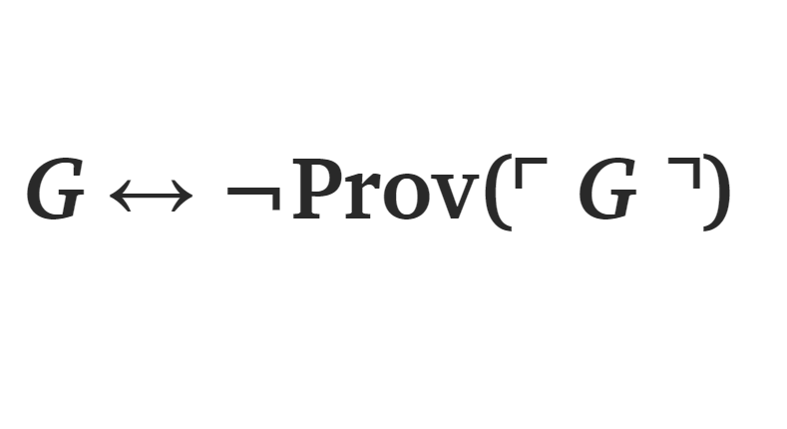
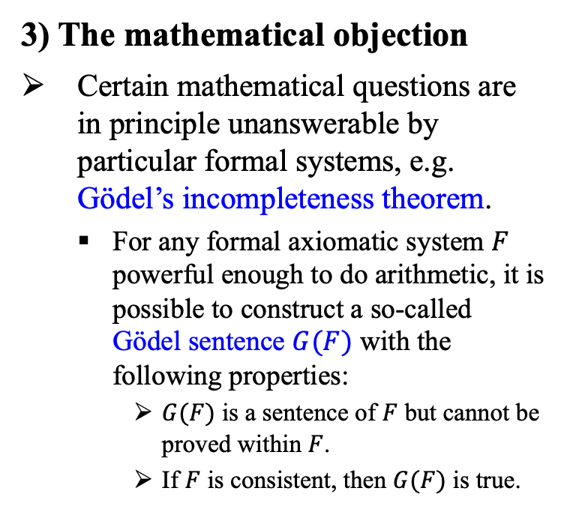
21.1 The Limits of AI (4/6)
3) The mathematical objection
Certain mathematical questions are in principle unanswerable by particular formal systems, e.g. Gödel’s incompleteness theorem.
For any formal axiomatic system $F$ powerful enough to do arithmetic, it is possible to construct a so-called Gödel sentence $G(F)$ with the following properties:
$G(F)$ is a sentence of $F$ but cannot be proved within $F$.
If $F$ is consistent, then $G(F)$ is true.
https://www.cantorsparadise.com/g%C3%B6dels-first-incompleteness-theorem-in-simple-symbols-and-simple-terms-7d7020c28ac4

Slide 13
21.1 The Limits of AI (5/6)
4) The argument from informality
This is the claim that the human behavior is far too complex to be captured by any simple set of rules and that because computers can do no more than follow a set of rule, they cannot generate behavior as intelligent as that of humans.
The inability to capture everything in a set of logical rules is called the qualification problem in AI.
The position they criticize came to be called “Good Old-Fashioned AI,” or GOFAI, a term coined by philosopher John Haugeland (1985).

Slide 14
21.1 The Limits of AI (6/6)
4) The argument from informality (cont.)
Dreyfus and Dreyfus (1986)’s Mind over Machines: points out several problems of AI, but these have been addressed with partial success and some with total success:
Good generalization from examples cannot be achieved without background knowledge.
It cannot operate autonomously without the help of a human trainer.
Learning algorithms do not perform well with many features, and if we pick a subset of features, “there is no known way of adding new features should the current set prove inadequate to account for the learned facts.”

Slide 15
21.2 Can Machines Really Think?

Slide 16
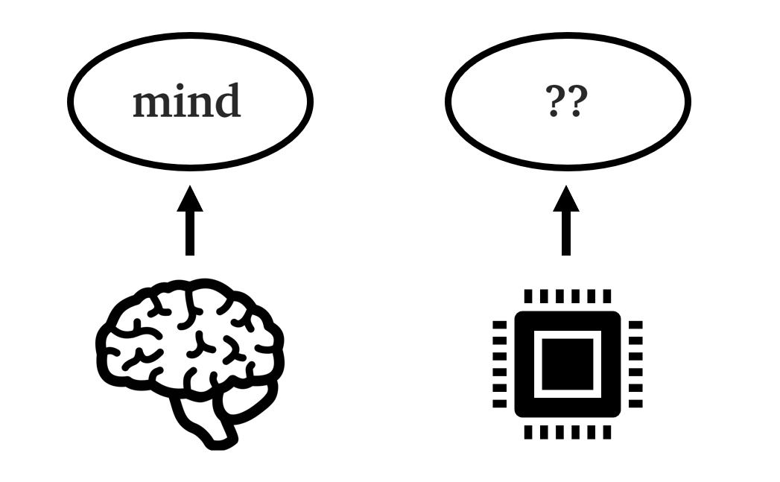
21.2 Can Machines Really Think? (1/7)
1) Strong AI
Strong AI hypothesis: Machines that think are actually thinking (not just simulating thinking)
(cf.) Weak AI hypothesis: Machines could act as if they were intelligent
The objection: Many philosophers have claimed that a machine that passes the Turing Test would still not be actually thinking, but would be only a simulation of thinking.
Consciousness, Phenomenology, Intentionality

Slide 17
21.2 Can Machines Really Think? (2/7)
1) Strong AI (cont.)
Mind-body problem: The question of whether machines could have real minds is directly relevant to the philosophical efforts to solve the mind-body problem:
Do humans have real mind? / Dualist / Monist
The problem for physicalists is to explain how physical states—in particular, the molecular configurations and electrochemical processes of the brain—can simultaneously be mental states, such as being in pain, enjoying a hamburger

Slide 18
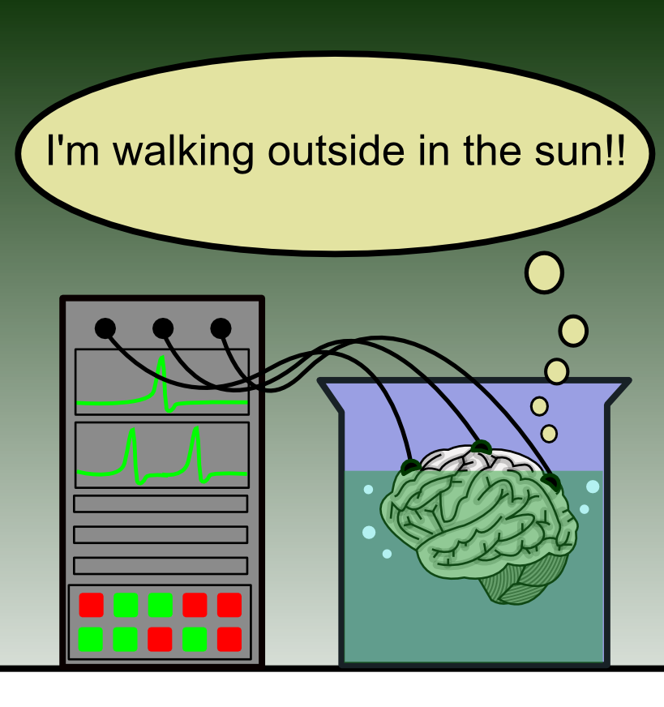
21.2 Can Machines Really Think? (3/7)
2) Mental states and the brain in a vat
If physicalism is correct, it must be the case that the proper description of a person’s mental state is determined by that person’s brain state.
The simplicity of this view is challenged by some simple thought experiments “brain in a vat”.
This example seems to contradict the view that brain states determine mental states.
It would be literally false to say that you have the mental state “knowing that one is eating a hamburger”.
Brain in a VAT. Psychology Wiki. (n.d.). Retrieved February 25, 2022, from https://psychology.fandom.com/wiki/Brain_in_a_vat

Slide 19
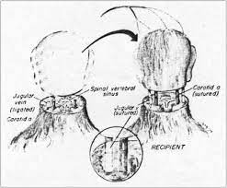
21.2 Can Machines Really Think? (4/7)
3) Functionalism and the brain replacement experiment
Functionalism: Under functionalist theory, any two systems with isomorphic causal processes would have the same mental states.
Therefore, a computer program could
have the same mental states as a person.
The claims of functionalism are illustrated most clearly by the brain replacement experiment
https://www.google.com/search?q=brain+replacement+experiment&tbm=isch&ved=2ahUKEwjjzOvjpKz3AhXGUPUHHXKZAhYQ2-cCegQIABAA&oq=brain+replacement+experiment&gs_lcp=CgNpbWcQAzoFCAAQgAQ6BggAEAcQHlD7A1j7A2DlBWgAcAB4AIABpwGIAZsCkgEDMC4ymAEAoAEBqgELZ3dzLXdpei1pbWfAAQE&sclient=img&ei=FwtlYqPlDMah1e8P8rKKsAE&bih=789&biw=1394#imgrc=oh3F93h9kmiM_M

Slide 20
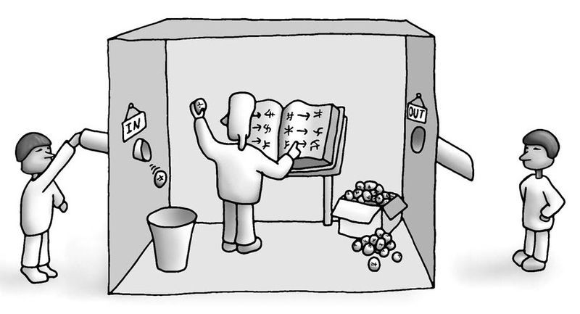
21.2 Can Machines Really Think? (5/7)
4) Biological naturalism and the Chinese Room
A strong challenge to functionalism has been mounted by John Searle’s (1980) biological naturalism: “Mental states are high-level emergent features that are caused by low-level physical processes in the neurons”
Thus, the mental states cannot be duplicated just on the basis of some program having the same functional structure with the same input-output behavior
To support this view, he proposed the Chinese Room thought experiment.

Slide 21
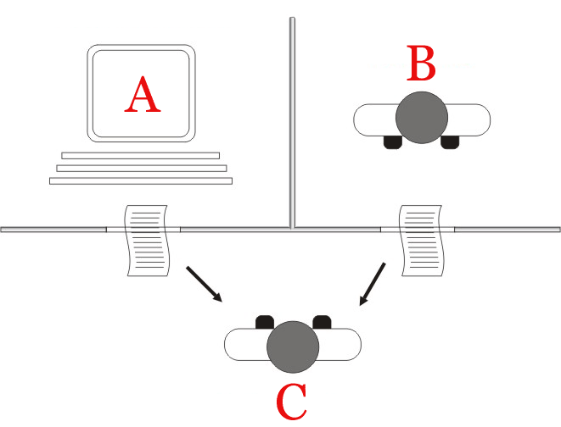
21.2 Can Machines Really Think? (6/7)
Chinese Room
Human in a room doesn’t know Chinese, but she has a rulebook for translating Chinese letters
If she is good at this translation, an observer outside the room will think she is fluent at Chinese
She never understood Chinese, but just followed the rulebook.
Conclusion (by Searle)
Understanding is not necessary to solve the problem
Computer programs: Syntactic
Human minds: Semantic
Syntax by itself is neither constitutive of nor sufficient for semantics
Source : https://commons.wikimedia.org/wiki/File:Test_de_Turing.jpg

Slide 22
21.2 Can Machines Really Think? (7/7)
5) Consciousness, qualia, and the explanatory gap
Running through all the debates about strong AI—the elephant in the debating room — is the issue of consciousness.
Aspects of consciousness: Understanding, self-awareness, subjective experience (feels like something to have certain brain states)
Qualia: intrinsic nature of experiences
Explanatory gap: neuroscience to cognitive science
Behaviors of several neurons can’t explain whole process of cognitive behavior
Humans are simply incapable of forming a proper understanding of their own consciousness

Slide 23
21.3 The Ethics of AI

Slide 24
21.3 The Ethics of AI (1/3)
So far, we have concentrated on whether we can develop AI, but we must also consider whether we should.
1) Risks of AI
What if the effects of AI technology are more likely to be negative than positive? In fact, AI poses some fresh problems, such as:
People might lose their jobs to automation.
People might have too much (or too little) leisure time.
People might lose their sense of being unique.
AI systems might be used toward undesirable ends.

Slide 25
21.3 The Ethics of AI (2/3)
2) Three sources of bigger risks of AI
State estimation may be incorrect, causing agent to do the wrong thing
Humans make more mistakes
Design a system with checks and balances
Finding right utility function is not easy
Reducing human suffering: no human, no suffering?
Techniques, such as apprenticeship learning, allow us to specify utility functions
Learning function may cause agent to evolve into unintended behaviors
Ultra-intelligent machines (Good, 1965)
Intelligence explosion, technological singularity

Slide 26

21.3 The Ethics of AI (2/3)
3) Three laws of robotics (Asimov, 1942)
A robot may not injure a human being or, through inaction, allow a human being to come to harm.
A robot must obey orders given to it by human beings, except where such orders would conflict with the First Law.
A robot must protect its own existence as long as such protection does not conflict with the First or Second Law.
4) How to design a Friendly AI?
Friendliness (a desire not to harm humans) should be designed in from the start, but the designers should recognize that the robot will learn and evolve over time.
To define the mechanism for evolving AI systems under a system of checks and balances.

Slide 27
21.4 AI Components

Slide 28
21.4 AI Components (1/3)
Let’s look at the components of an intelligent agent to assess what’s known and what’s missing. We consider the utility-based agent with a learning component and see where the state-of-the-art stands for each of the components.
<출처> Stuart J. Russell and Peter Norvig (2021). Artificial Intelligence: A Modern Approach (4th Edition). Pearson

Slide 29
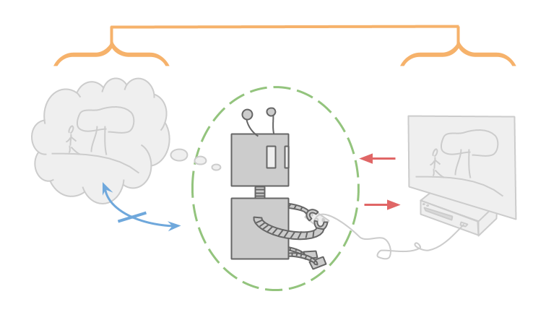
21.4 AI Components (2/3)
Advances and opportunities for further progress
1) Interaction with the environment through sensors and actuators
Present: Availability of ready-made programmable robots, and sensors and actuators getting more elaborate
Future: AI systems are at the cusp of moving from software-only systems to embedded robotic systems
2) Keeping track of the state of the world
Present: Filtering algorithms for probabilistic reasoning in atomic and factored state representations
Future: Probability and first-order logic representations coupled with aggressive machine learning

Slide 30
21.4 AI Components (3/3)
Advances and opportunities for further progress
3) Projecting, evaluating, and selecting future courses of action
Present: Hierarchical reinforcement learning has succeeded for decision making
Future: How the search for effective long-range plans might be controlled
4) Utility as an expression of preferences
Present: Rational decisions based of maximization of expected utility.
Future: Knowledge engineering for reward functions to convey to the agents what we want them to do
5) Learning
Present: Machine learning today assumes a factored representation
Future: Gradually constructing new representations at levels of abstraction higher than the input vocabulary

Slide 31
21.5 AI Architectures

Slide 32
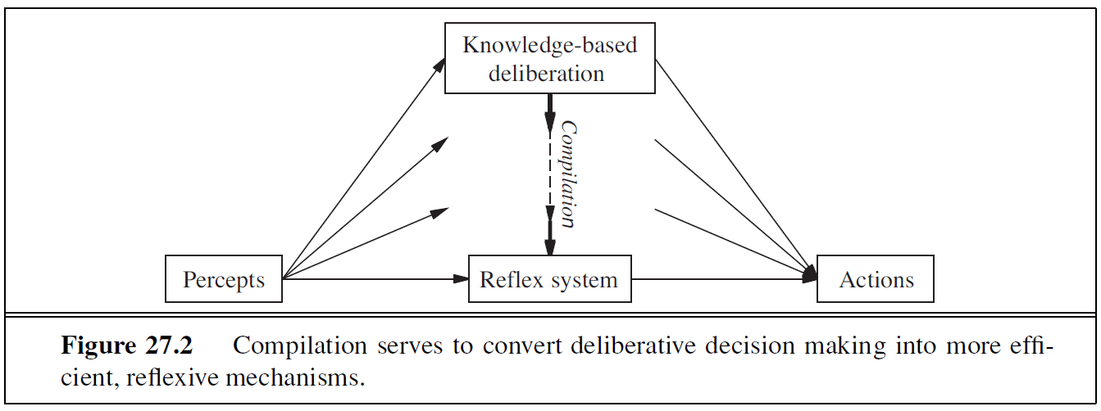
21.5 AI Architectures (1/5)
1) Hybrid architecture
Reflex responses are needed for situations in which time is of the essence, whereas knowledge-based deliberation is needed for plan ahead.
A complete agent must be able to do both, using a hybrid architecture.
Agents also need ways to control their own deliberations. Cease deliberating when action is demanded and use the time available for deliberation to execute the most profitable computations.
Real-time deliberation is also important: real-time AI
<출처> Stuart J. Russell and Peter Norvig (2021). Artificial Intelligence: A Modern Approach (4th Edition). Pearson

Slide 33
21.5 AI Architectures (2/5)
2) General methods of controlling deliberation
1. Employ anytime algorithms
An algorithm whose output quality improves gradually over time.
2. Decision-theoretic metareasoning
The value of a computation depends also on its cost
Metareasoning can be used to design better search algorithms and to guarantee that the algorithms have the anytime property.
3. Reflective architecture: Meta-reasoning is one specific example of a reflective architecture.

Slide 34
21.5 AI Architectures (3/5)
Whether AI’s current path is more like a tree climb or a rocket trip?
1) Rationally acting agents: four possibilities
Perfect rationality: finds best way to maximize its own expected utility always, but it is too time consuming (not realistic)
Calculative rationality: a calculative rational agent eventually returns what would have been the rational choice at the beginning of its deliberation
Bounded rationality: deliberating only long enough to come up with an answer that is “good enough” (or satisficing) (Simon, 1957)
Bounded optimality: a bounded optimal agent behaves as well as possible, given its computational resources

Slide 35
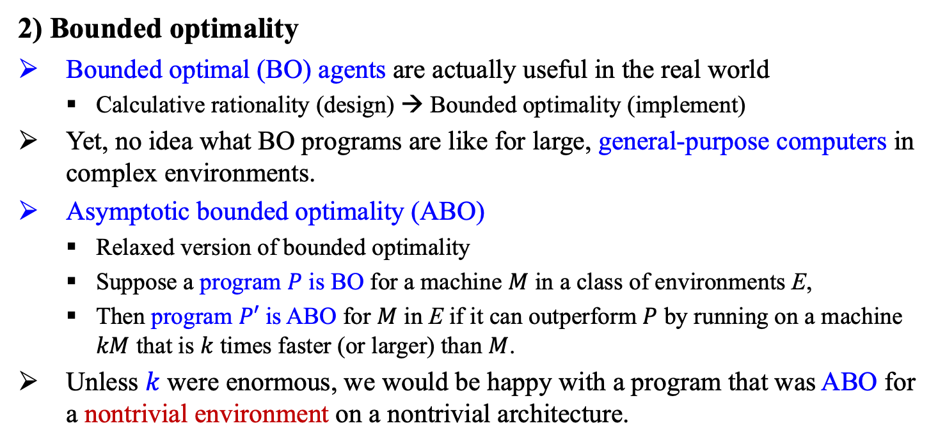
21.5 AI Architectures (4/5)
2) Bounded optimality
Bounded optimal (BO) agents are actually useful in the real world
Calculative rationality (design) → Bounded optimality (implement)
Yet, no idea what BO programs are like for large, general-purpose computers in complex environments.
Asymptotic bounded optimality (ABO)
Relaxed version of bounded optimality
Suppose a program $P$ is BO for a machine $M$ in a class of environments E,
Then program $P′$ is ABO for $M$ in E if it can outperform $P$ by running on a machine $kM$ that is $k$ times faster (or larger) than $M$.
Unless $k$ were enormous, we would be happy with a program that was ABO for a nontrivial environment on a nontrivial architecture.

Slide 36
21.5 AI Architectures (4/5)
Will AI be used for good or ill?
AI developers have a responsibility to see that the impact of their work is a positive one. The scope of impact will depend on the degree of successes of AI.
Even moderate successes in AI have already changed the ways in which computer science is taught and software development is practiced.
Medium-level successes in AI would affect all kinds of people in their daily lives.
Personal assistants, automated driving, autonomous weapons, genomics,
Large-scale success in AI—the creation of human-level intelligence and beyond —will change our life and future of human race.
Alan Turing(1950): We can see only a short distance ahead, but we can see that much remains to be done.

Slide 37
Summary
We use the term weak AI for the hypothesis that machines could possibly behave intelligently, and strong AI for the hypothesis that such machines would count as having actual minds (as opposed to simulated minds).
Alan Turing rejected the question “Can machines think?” and replaced it with a behavioral test. He anticipated many objections to the possibility of thinking machines.
We identified six potential threats to society posed by AI and related technology. One threat in particular is worthy of further consideration: that ultraintelligent machines might lead to a future that is very different from today.
Components of an intelligent agent to assess what’s known and what’s missing: Interaction with the environment, keeping track of the state of the world, projecting/evaluating/selecting future courses of action, utility, and learning.
For controlling deliberation, employ anytime algorithms, or apply decision-theoretic metareasoning.
The goal of AI: Perfect rationality, calculative rationality, bounded rationality, bounded optimality.
We can expect that medium-level successes in AI would affect all kinds of people in their daily lives.
It seems likely that a large-scale success in AI—the creation of human-level intelligence and beyond—would change the lives of a majority of humankind.

